Slide 1
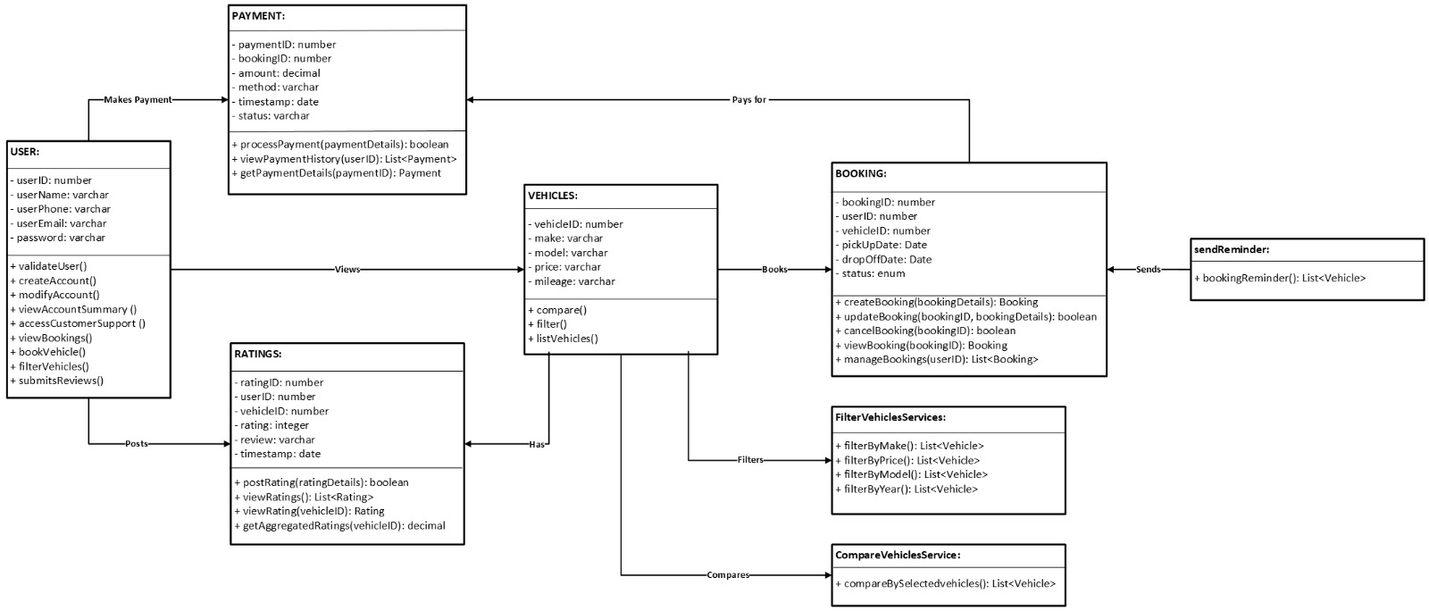
CLASS DIAGRAM (EzCars)

